Slide 1
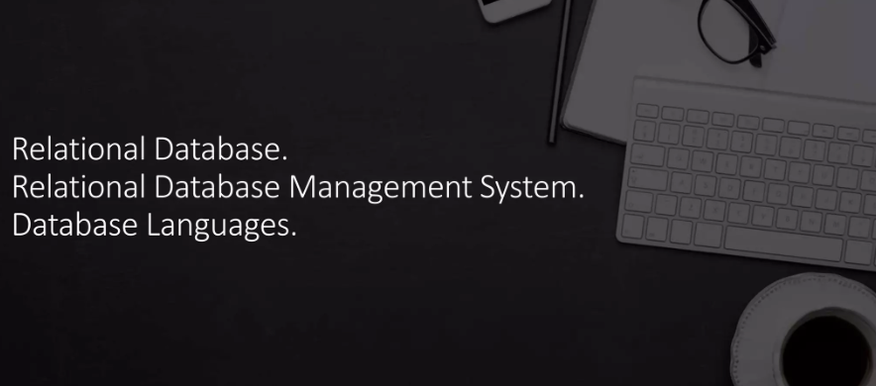

Slide 2
What is the information and how to generate an information?
Notes:
What is Information?
Information is processed, organized, or structured data that provides meaning or context to the raw data. It is essential for decision-making, problem-solving, and understanding situations. Data becomes information when it is interpreted and understood within a given context.
Data refers to raw, unprocessed facts or figures (e.g., numbers, words, or symbols) that on their own may not make much sense.
Information is the result of processing, organizing, or structuring that data to make it meaningful.
For example:
Data: 37, 98, 45, 72
Information: These are the test scores of four students.
When data is collected, analyzed, and interpreted in context, it becomes useful and relevant, which turns it into information.
How to Generate Information?
Generating information involves several steps, starting from collecting raw data to transforming it into useful insights. Here's how you can generate information:
Collect Data: The first step is gathering raw data. Data can come from various sources like surveys, sensors, research, or databases.
Examples of data: A list of customer purchases, a collection of sensor readings, or responses from a survey.
Process Data: Raw data needs to be processed to eliminate any errors or inconsistencies. This step can involve filtering, sorting, or correcting data.
Example: Removing duplicate entries in a dataset, converting data formats, or cleaning up invalid data entries.
Organize Data: Once processed, data should be organized to highlight patterns or connections. This can involve grouping similar items, sorting data by categories, or summarizing data.
Example: Organizing sales data by region, customer age group, or time of purchase.
Analyze Data: Analysis involves applying tools and techniques like statistical methods, algorithms, or business logic to the organized data. This helps extract insights, trends, or patterns.
Example: Analyzing data to find customer buying trends or identifying which products are most popular.
Interpret Data: Interpretation means giving meaning to the analyzed data by understanding its implications within the given context.
Example: Interpreting that sales of a product increased because of a specific marketing campaign or that a rise in temperature readings suggests a malfunction in a machine.
Present as Information: Finally, present the processed and interpreted data in a clear and meaningful format, such as charts, graphs, reports, or dashboards, which makes the information easy to understand and use.
Example: A graph showing quarterly sales increases or a report summarizing customer satisfaction trends.
Example of Turning Data into Information:
Let’s say a school collects the following data for student grades:
Student ID Math Score Science Score English Score
1001 85 90 88
1002 76 80 82
1003 92 88 91
Raw Data: The individual test scores are the data.
Processing: Calculate the average score for each student.
Organizing: Sort students based on their average score.
Analyzing: Determine trends (e.g., if students score higher in math).
Interpreting: Conclude which subject needs more focus based on the trends.
Information: Report the findings, showing which subject most students excel in and which needs improvement.
In Summary:
Information is processed data that is meaningful and useful.
To generate information, you collect data, process it, analyze it, and interpret it to derive useful insights.
Tools like database systems (e.g., MySQL), spreadsheets (e.g., Excel), or statistical software can be used to process and organize data into meaningful information.
Would you like to explore how this process applies to databases or real-world business scenarios?

Slide 3
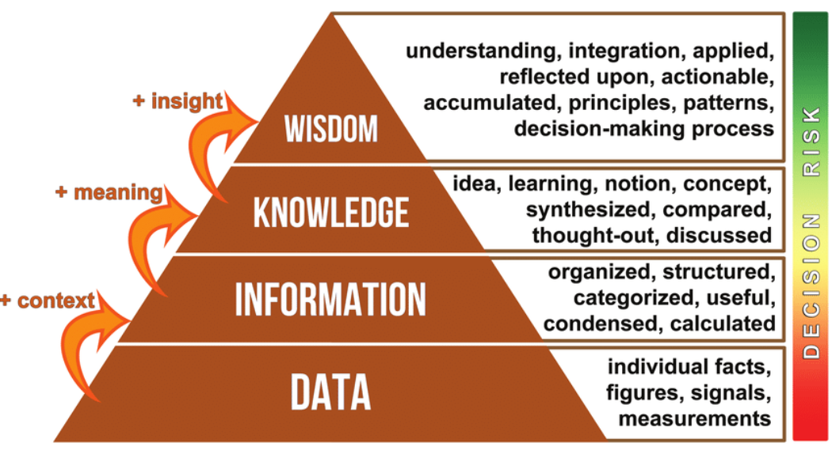

Slide 4
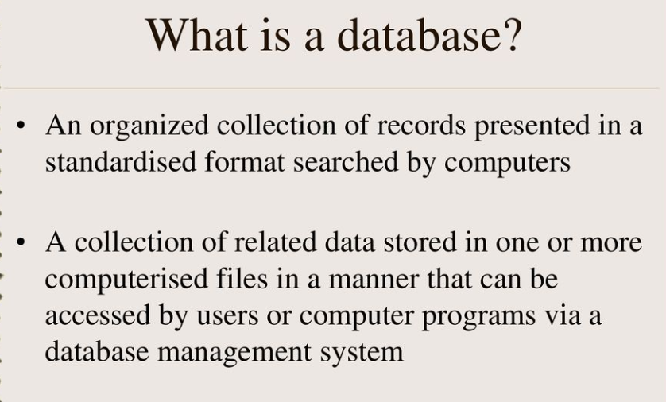

Slide 5
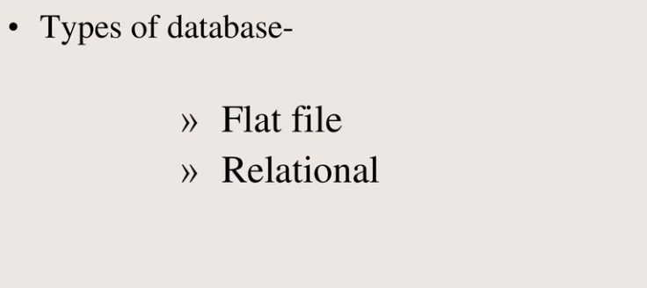

Slide 6
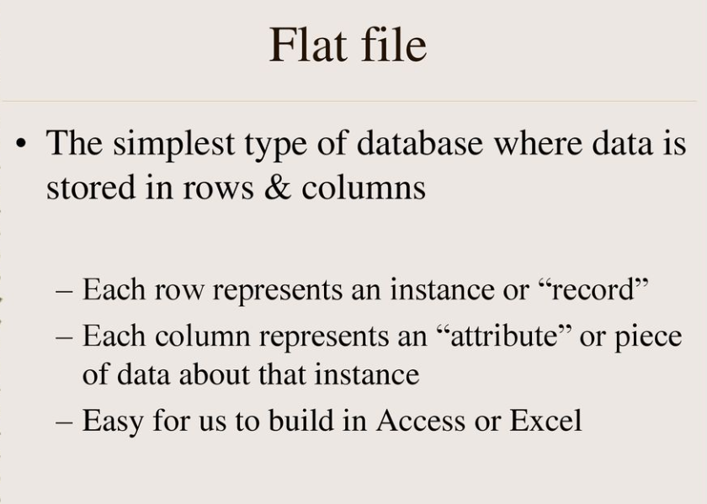

Slide 7
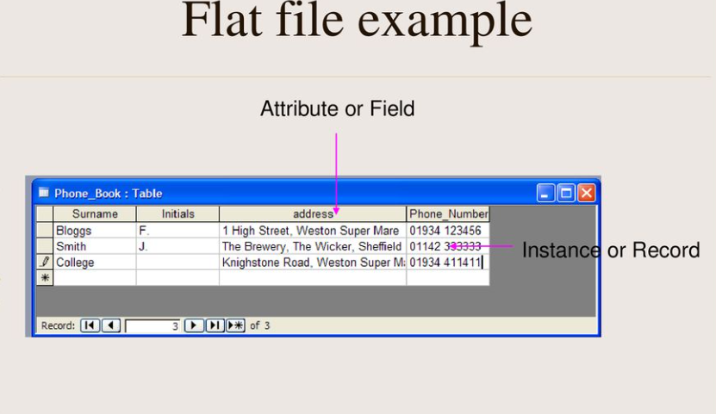

Slide 8
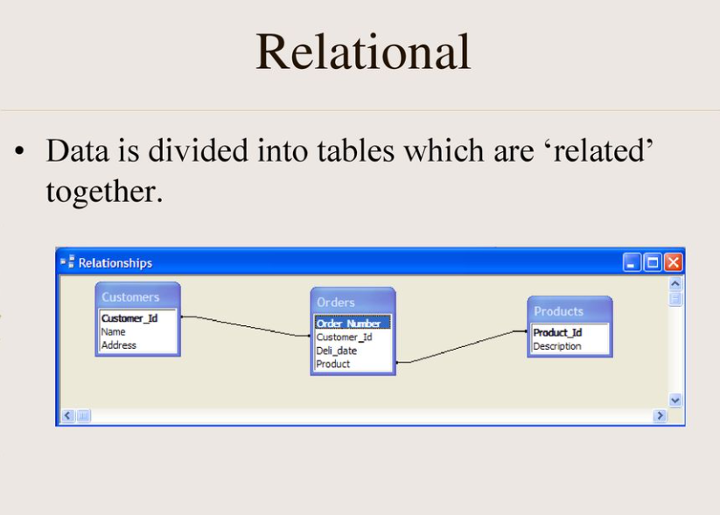

Slide 9
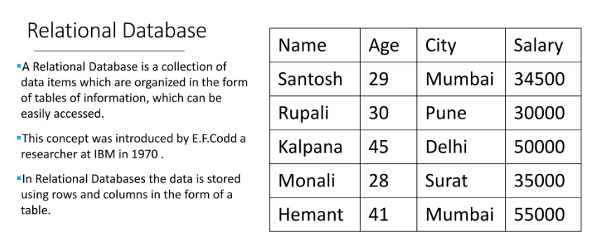

Slide 10
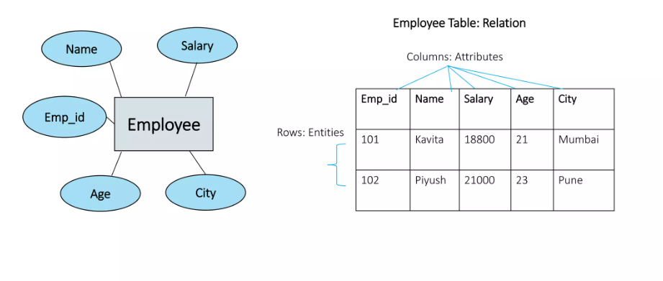

Slide 11
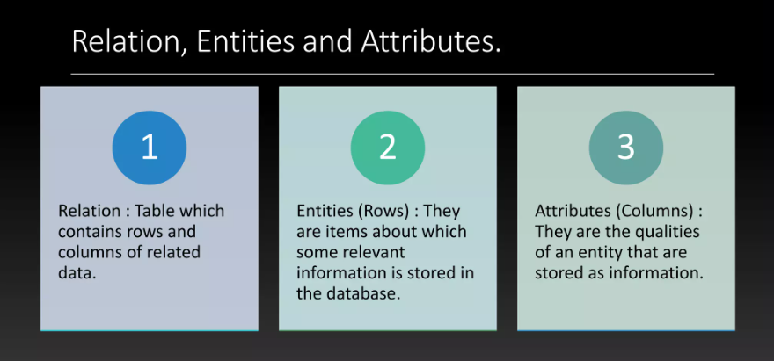

Slide 12
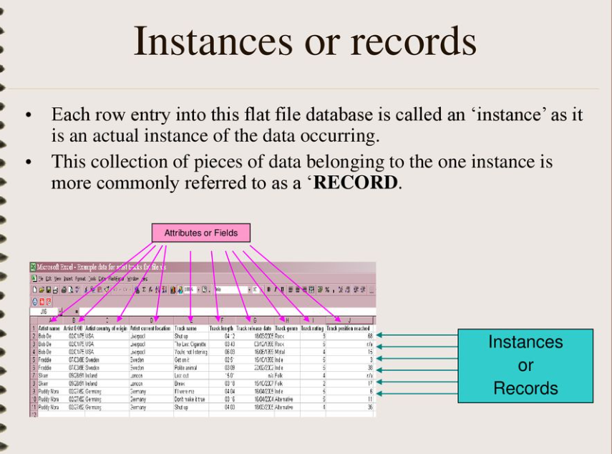

Slide 13
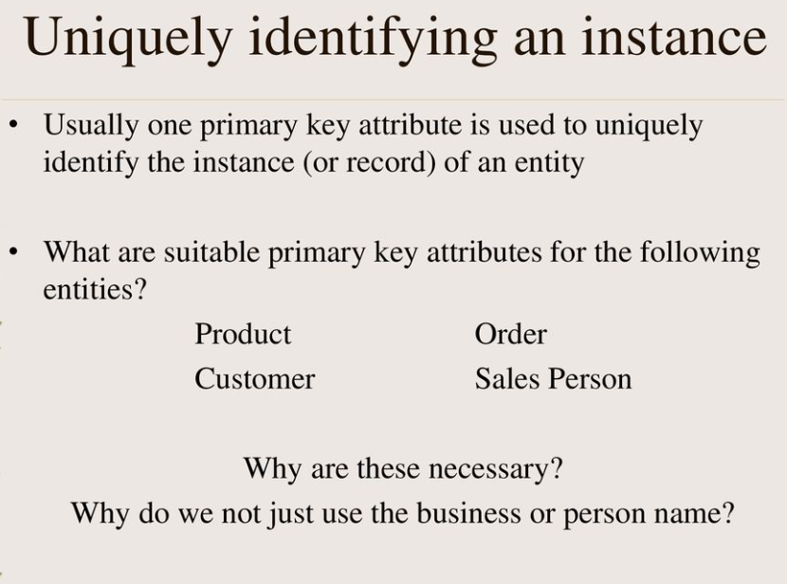

Slide 14
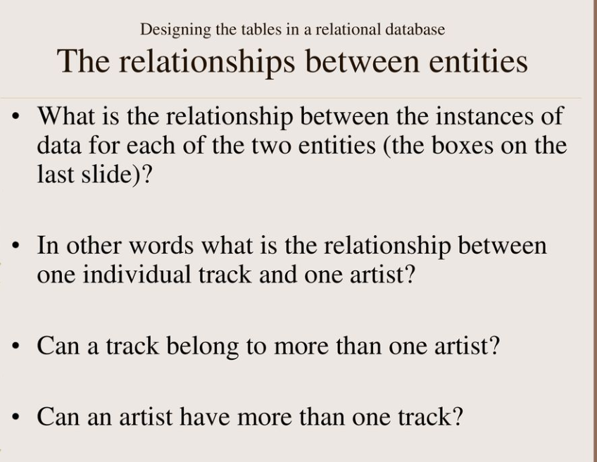

Slide 15
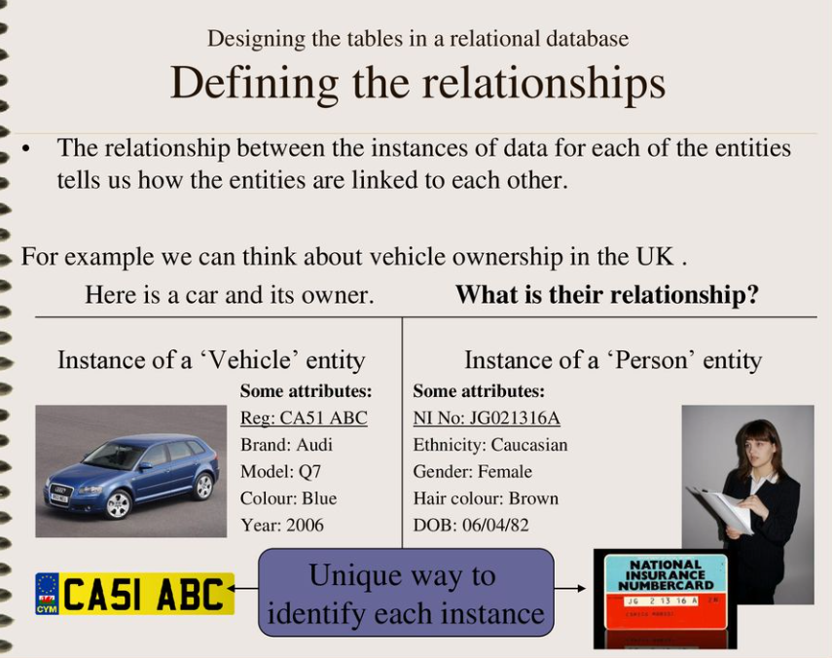

Slide 16
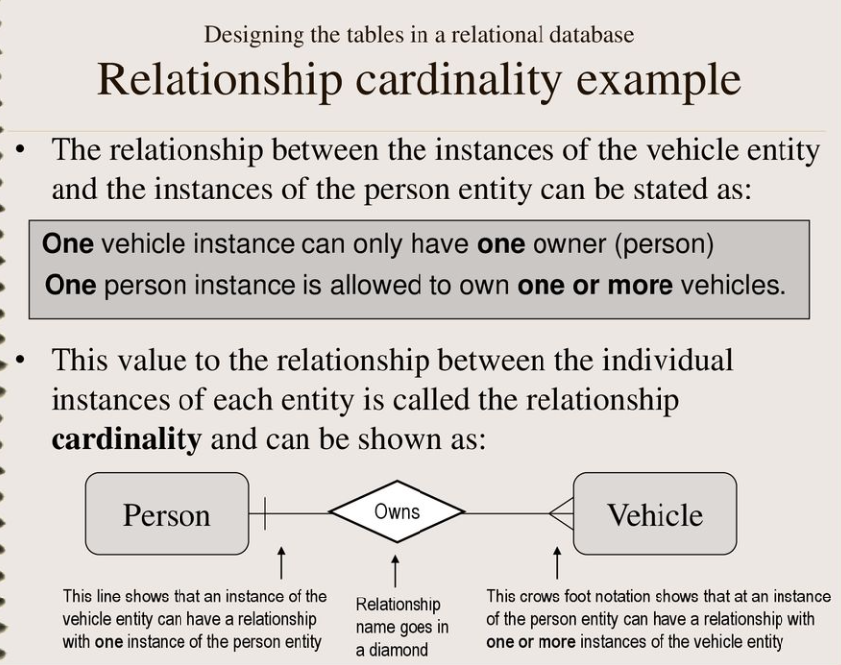

Slide 17
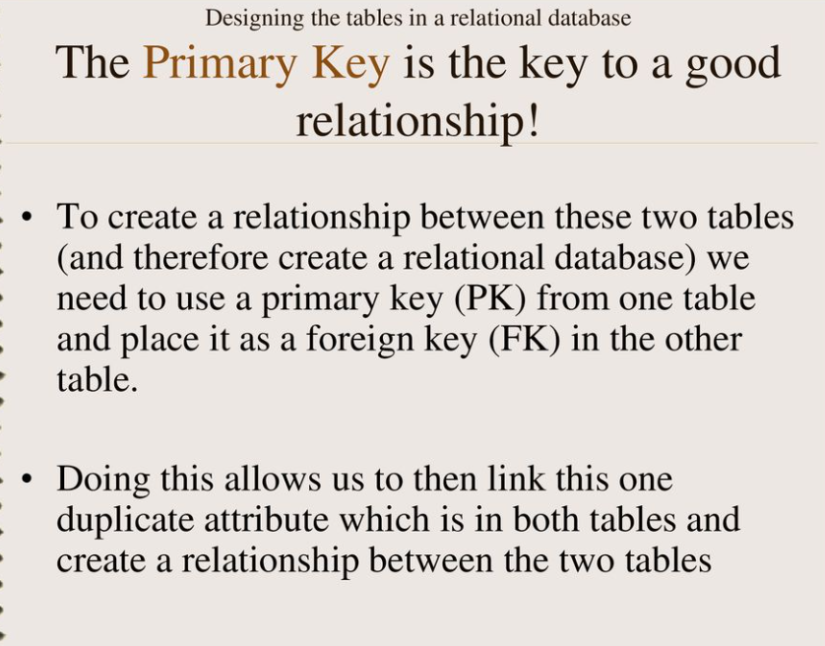

Slide 18
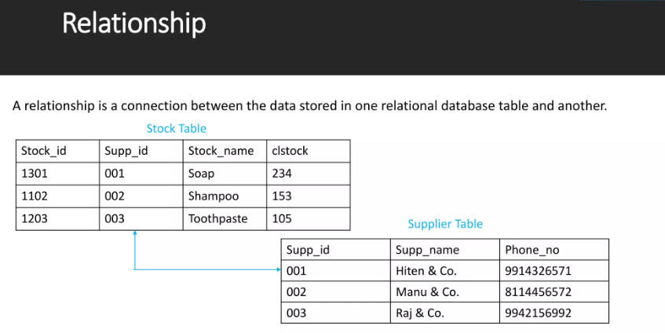

Slide 19
Task 2:
Describe One to one, One to many and many to many relationship with examples
Positives and negatives of relational database
SQL and NoSQL databases similarities and differences

Slide 20


Slide 21
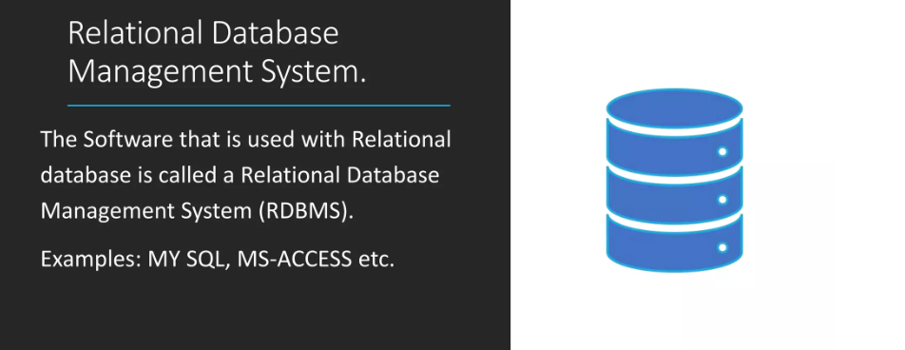

Slide 22
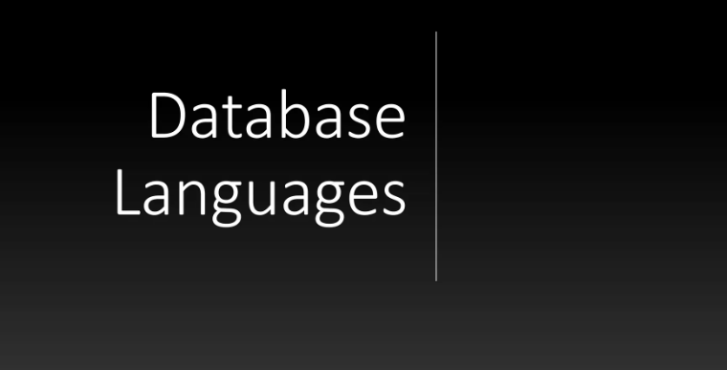

Slide 23
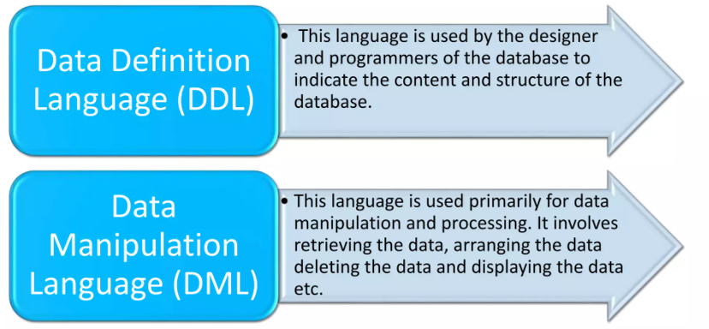

Slide 24
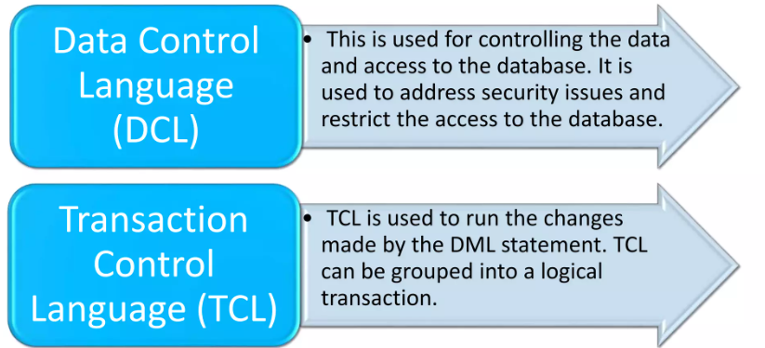

Slide 25
Task 3: Create: ERD and DFD
Choose from the list:
School/college/university
Retail/shop/stock
Restaurant/pub/caffe
Hotel/B&B

Slide 26
What is Normalization?
Normalization is the process of organizing the data in the database.
Normalization is used to minimize the redundancy from a relation or set of relations.
It helps you avoid redundancy and maintain the integrity of the database. It also helps you eliminate undesirable characteristics associated with insertion, deletion, and updating.

Slide 27
What is the Purpose of Normalization?
The main purpose of database normalization is to avoid complexities, eliminate duplicates, and organize data in a consistent way. In normalization, the data is divided into several tables linked together with relationships.
Database administrators can achieve these relationships by using primary keys, foreign keys, and composite keys.

Slide 28
Normalization
Advantages of Normalization
Normalization helps to minimize data redundancy.
Greater overall database organization.
Data consistency within the database.
Much more flexible database design.
Disadvantages of Normalization
You cannot start building the database before knowing what the user needs.
It is very time-consuming and difficult to normalize relations of a higher degree.
decomposition may lead to a bad database design, leading to serious problems.

Slide 29
1NF (First Normal Form) Rules
Each table cell should contain a single value.
Each record needs to be unique.

Slide 30
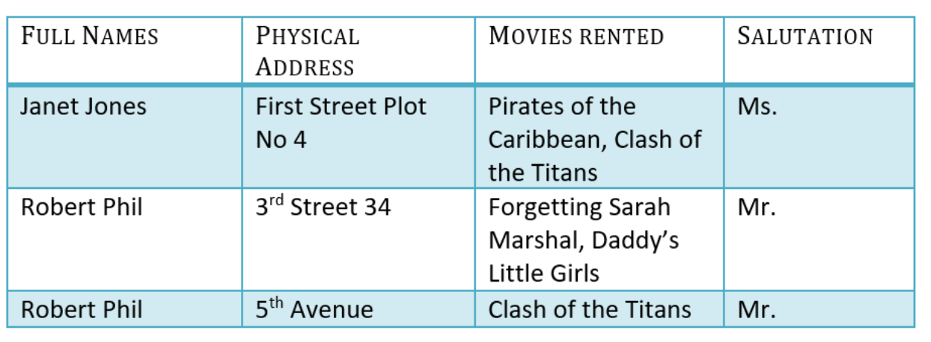
Example of Normalization (1NF)

Slide 31

What is a Primary Key?
A primary is a single column value used to identify a database record uniquely.

Slide 32
2NF (Second Normal Form) Rules
Rule 1- Be in 1NF
Rule 2- Single Column Primary Key that does not functionally dependant on any subset of candidate key relation

Slide 33
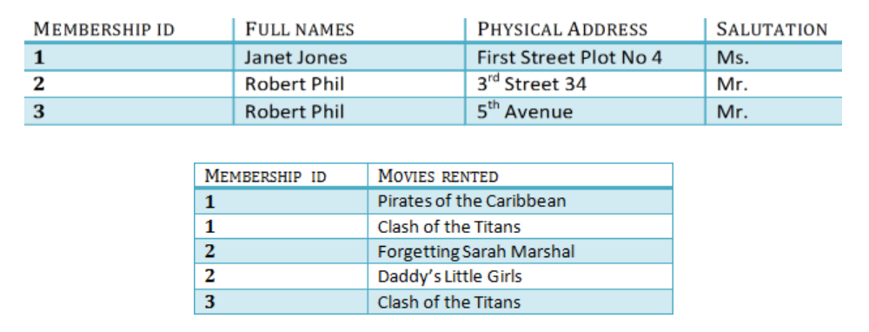
Example of Normalization (2NF)
We have divided our 1NF table into two tables viz. Table 1 and Table2. Table 1 contains member information. Table 2 contains information on movies rented.
We have introduced a new column called Membership_id which is the primary key for table 1. Records can be uniquely identified in Table 1 using membership id
Database – Foreign Key
In Table 2, Membership_ID is the Foreign Key

Slide 34
3NF (Third Normal Form) Rules
Rule 1- Be in 2NF
Rule 2- Has no transitive functional dependencies

Slide 35
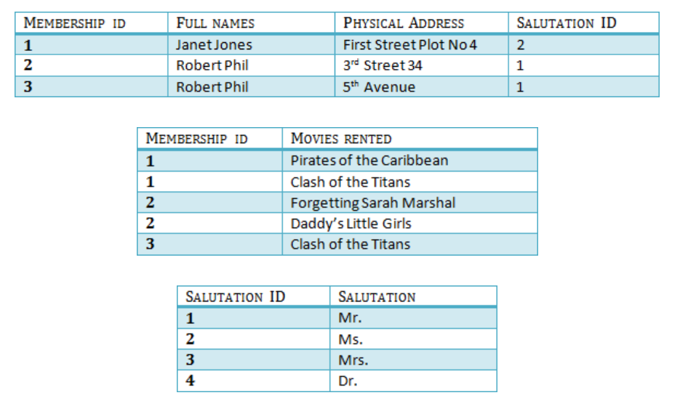
Example of Normalization (3NF)
There are no transitive functional dependencies, and hence our table is in 3NF
In Table 3 Salutation ID is primary key, and in Table 1 Salutation ID is foreign to primary key in Table 3

Slide 36
Task 4: Develop Normalization on the chosen database (task 3)?
NF1
NF2
NF3

